Slide 1
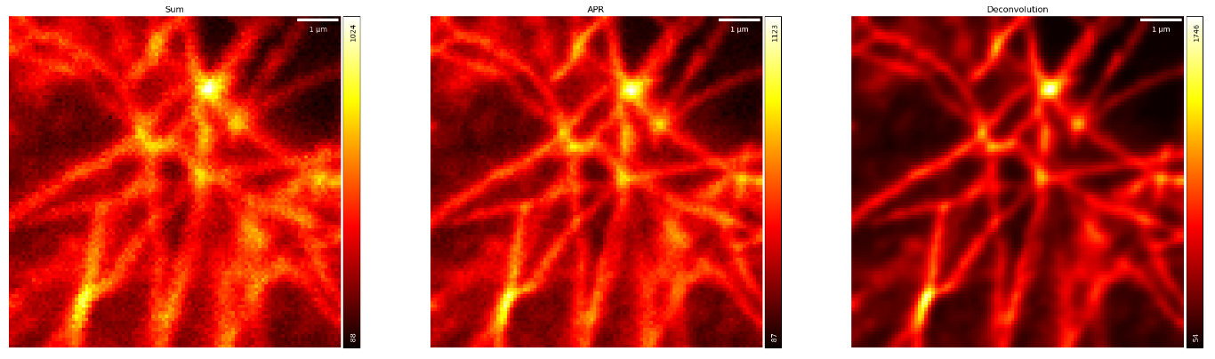
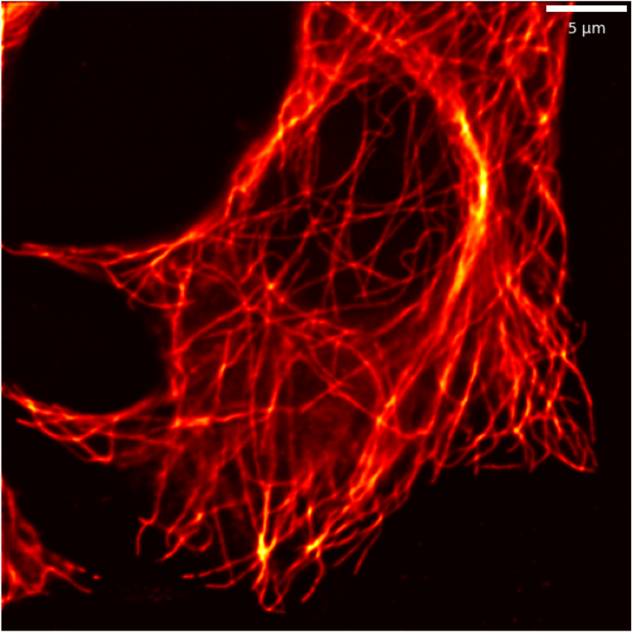
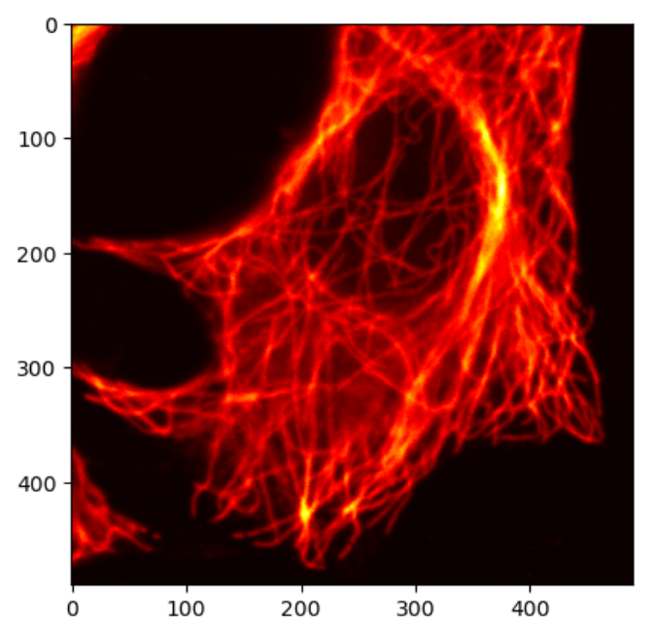
ISM
Confocal

Slide 2
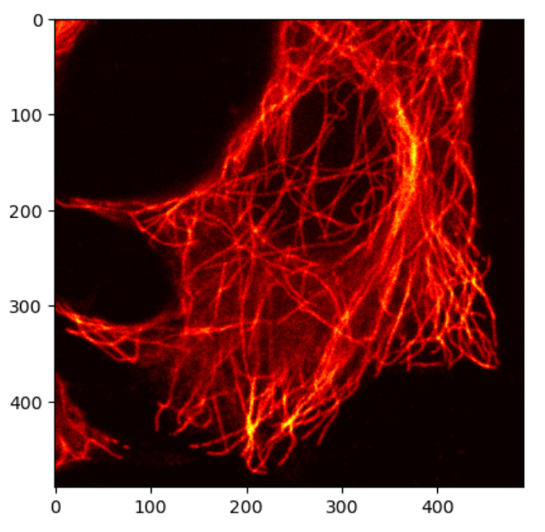

Università di Milano Bicocca
Dipartimento di Fisica
‘G. Occhialini’
Image Scanning Microscopy
Beyond the limits of confocal resolution
Riccardo Bolzoni
PhD student
Course of Biotonica
20/12/2023

Slide 3
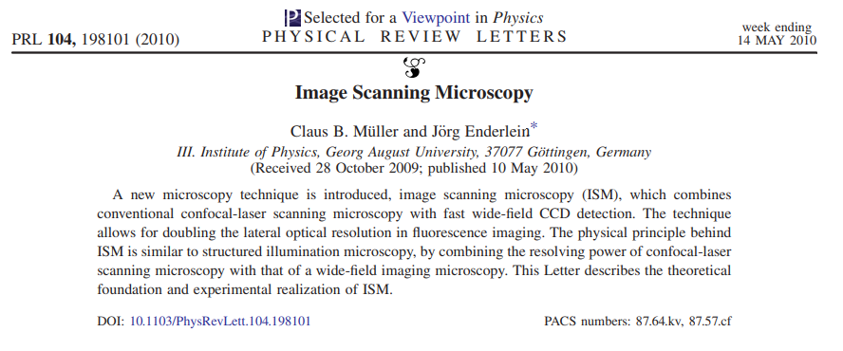
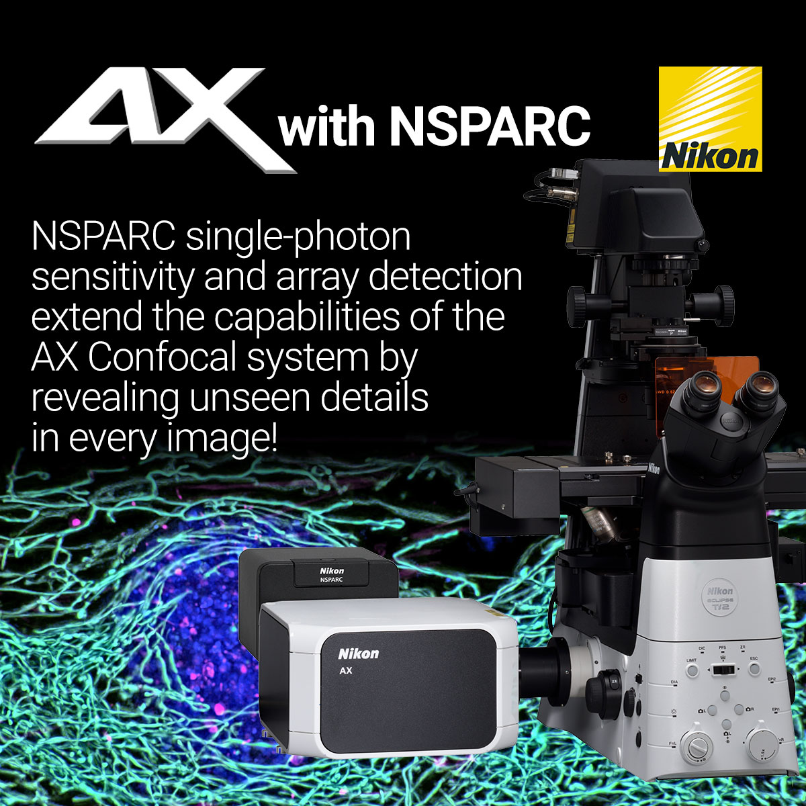
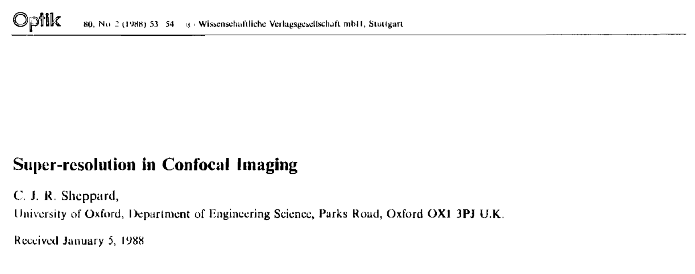
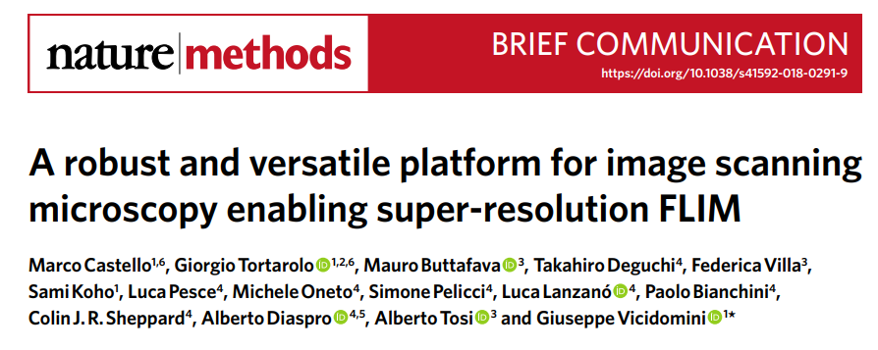
Why ISM?
Image Scanning Microscopy allows to go beyond the traditional diffraction-limited resolution with minimal changes to the optical setup and can be easily adapted for various imaging techniques
1988: theoretical description
2010: realization with a CCD
2019: realization with a SPAD array
Februrary 2023: first commercial release

Slide 4
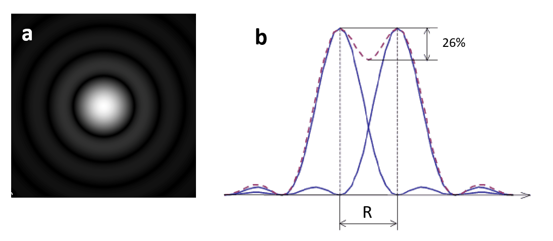
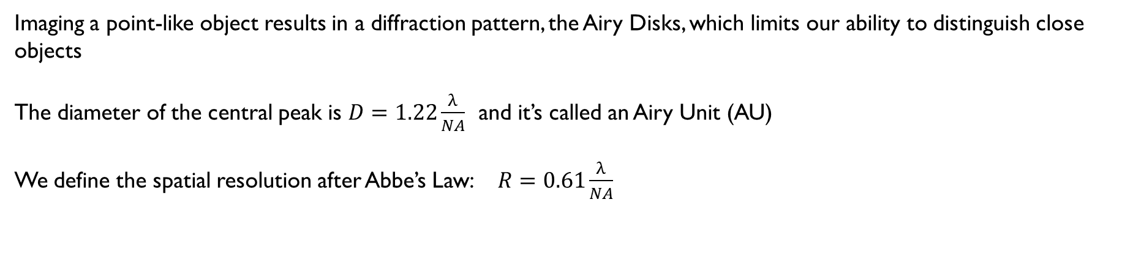
Let’s start from the beginning…
Imaging a point-like object results in a diffraction pattern, the Airy Disks, which limits our ability to distinguish close objects
The diameter of the central peak is $D=1.22\frac{λ}{NA}$ and it’s called an Airy Unit (AU)
We define the spatial resolution after Abbe’s Law: $R=0.61\frac{λ}{NA}$

Slide 5
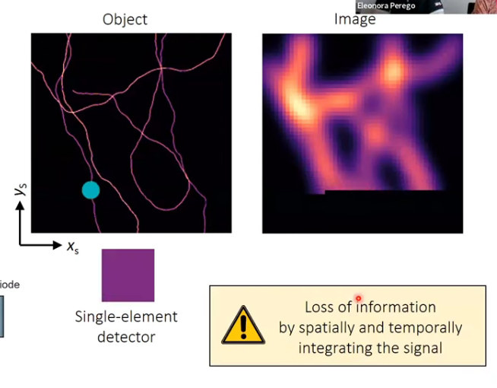
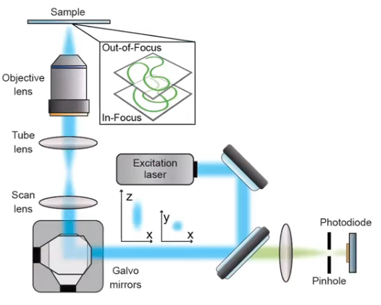
Confocal microscope
In a typical confocal microscope i scan the sample and assign, to every scanned pixel, the total intensity detected after the pinhole

Slide 6
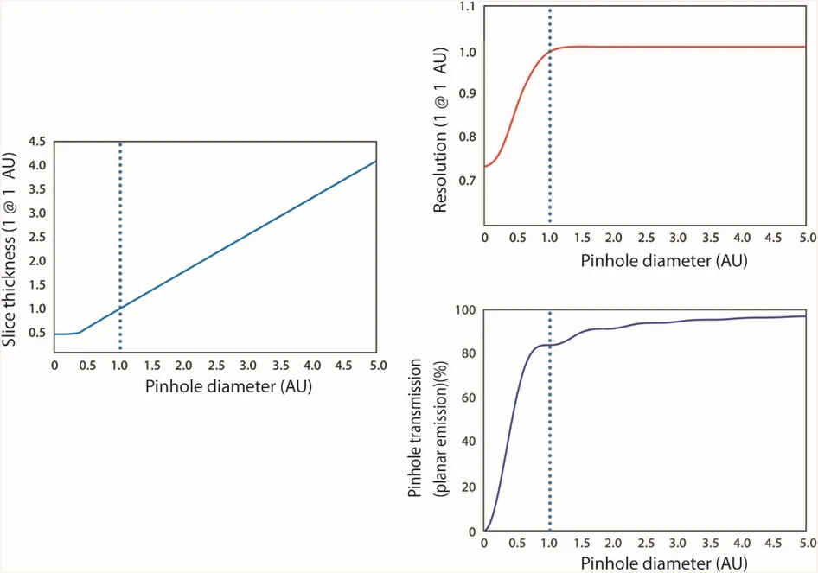
Pinhole and resolution
The transversal and axial spatial resolutions in a confocal system are deeply linked to the pinhole aperture
Smaller pinhole = better z-sectioning
Smaller pinhole = higher xy res.
Smaller pinhole = lower signal

Slide 7
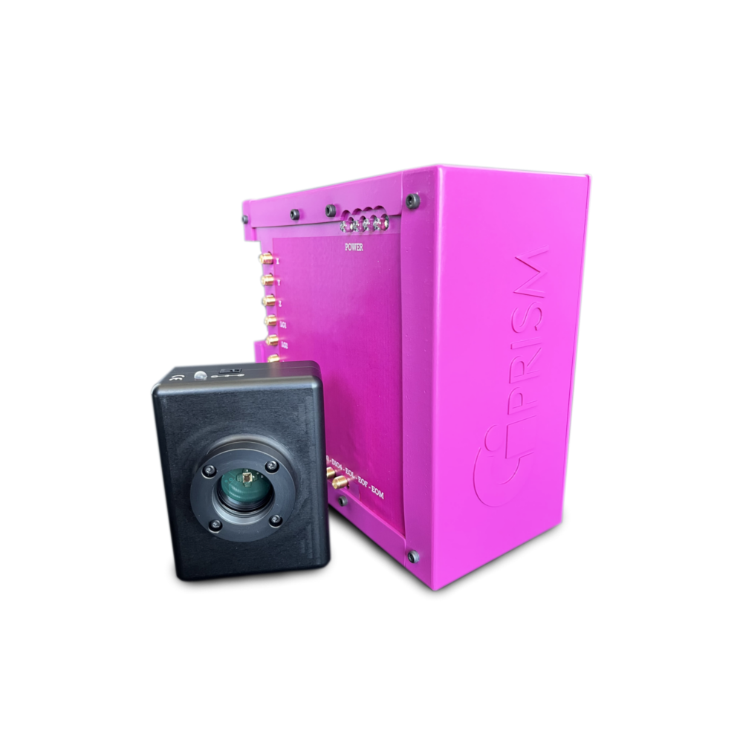
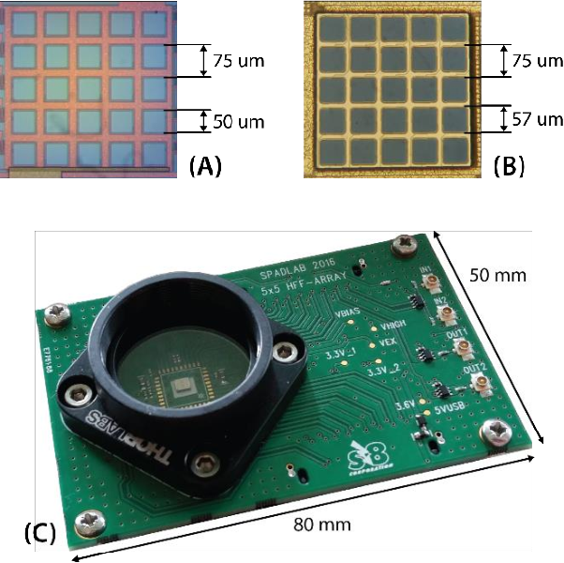
Image Scanning Microscopy
In ISM the single-pixel detector is substituted by a SPAD array
The SPAD array has several useful characteristics:
Asynchronous readout of the photon's arrival with an overall temporal resolution of ∼100 ps
The 5x5 array is ∼400 µm, with a fill factor of ∼44% compensated by an array of micro-lenses
The size of the detector on the sample plane is tunable but set to 1.0 ∼ 1.4 AU. Every SPAD works as a 0.2 AU pinhole!
Overall, the array works as a camera with ‘unlimited’ framerate
75 µm
1.4 AU
50 µm

Slide 8
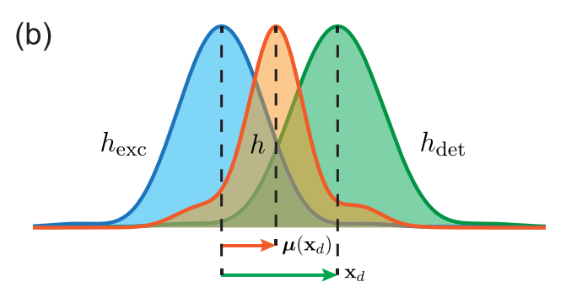
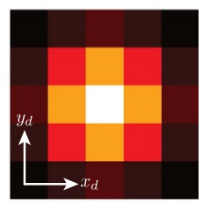
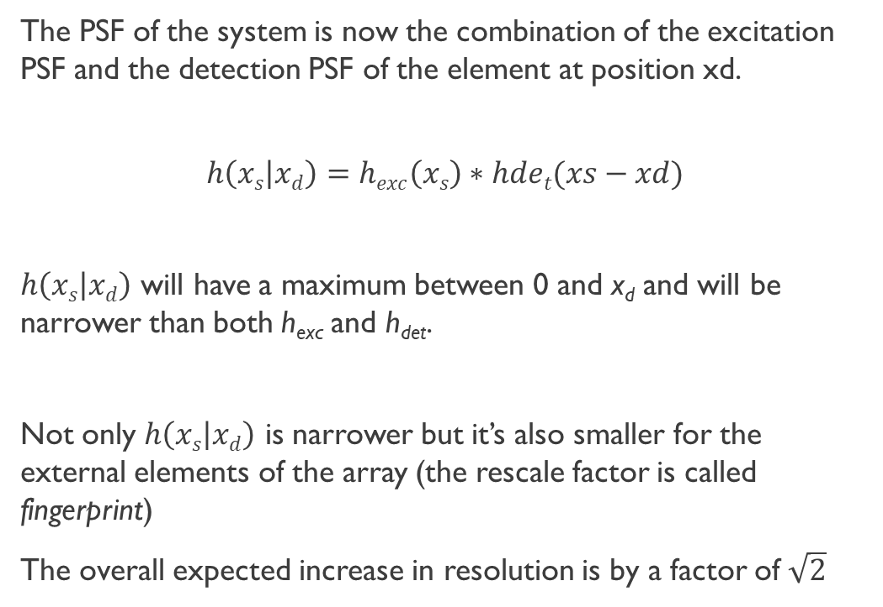
The ISM theory
The PSF of the system is now the combination of the excitation PSF and the detection PSF of the element at position xd.
$$h\left(xs | xd\right)=hexc\left(xs\right)∗hdet(xs−xd)$$
$h\left(xs | xd\right)$ will have a maximum between 0 and x_{d} and will be narrower than both h_{exc} and h_{det}.
Not only $h\left(xs | xd\right)$ is narrower but it’s also smaller for the external elements of the array (the rescale factor is called fingerprint)
The overall expected increase in resolution is by a factor of $\sqrt{2}$
Schematic view of total PSF for the array elements (up) and fingerprint of the array (down)

Slide 9
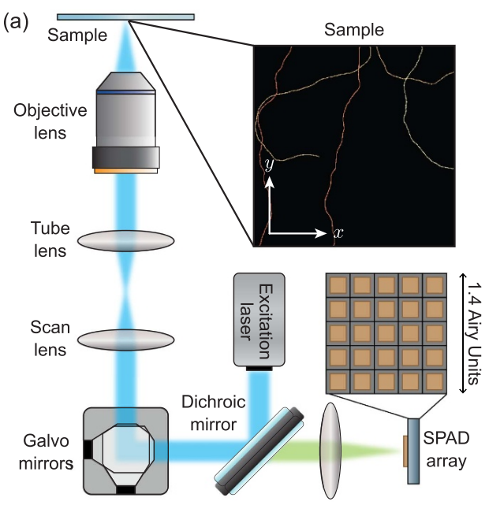
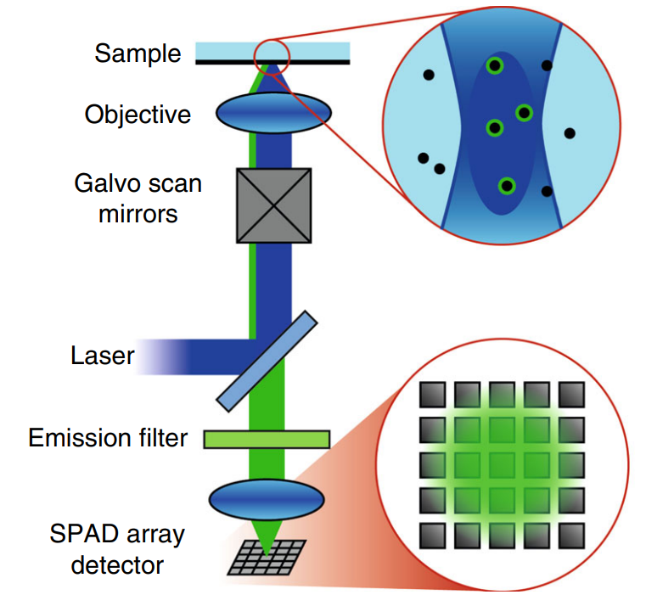
ISM setup
See also ‘Unlocking New Frontiers in Microscopy: The Bright-Eyes TTM Seminar by Eleonora Perego & Eli Slenders’, https://www.youtube.com/watch?v=aQxKkF7O8i8

Slide 10
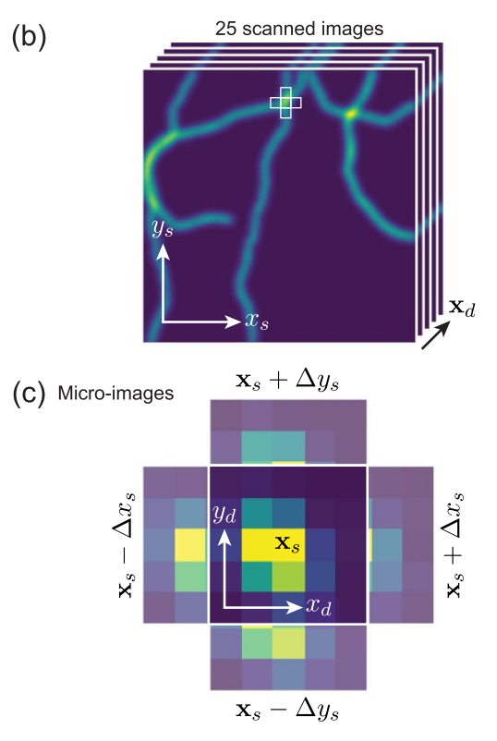
The ism dataset
The data is intrinsically 4D: x,y position of the scan and x,y position of the detector). It can be seen as a 5x5 micro-image for every scanned pixel or as 25 NxN shifted images (one for every SPAD)
In addition, every pixel contains the information on the time evolution of the detected signal
In practice the data are stored in a 6-dimensional form: (x_{scan}, y_{scan}, z_{scan}, t, channel, rep.)

Slide 11
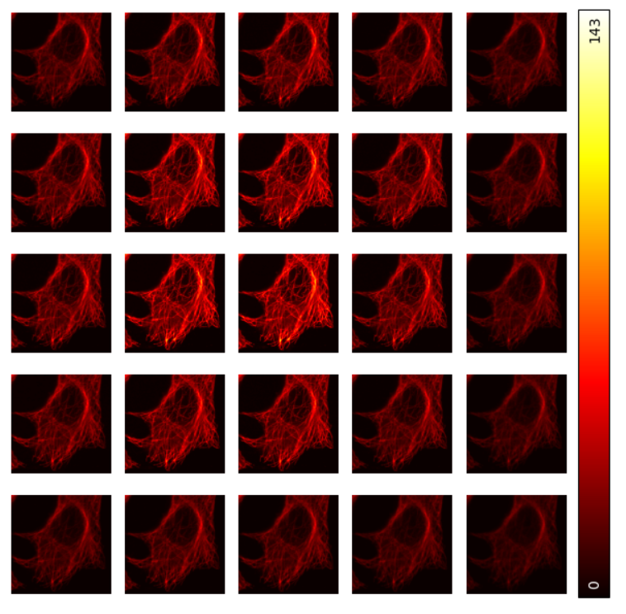
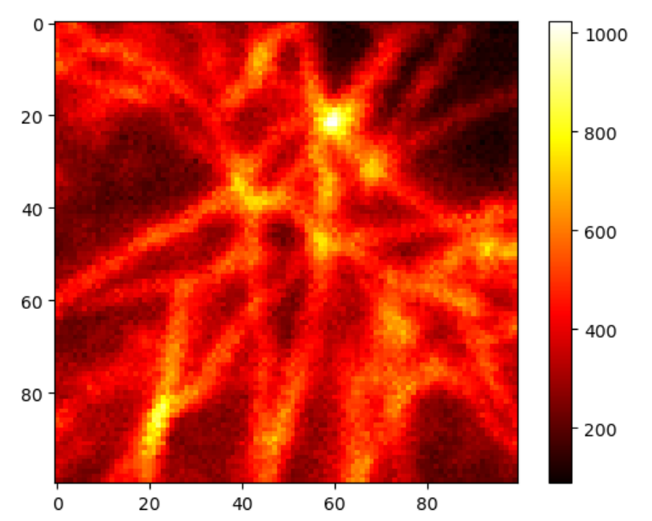
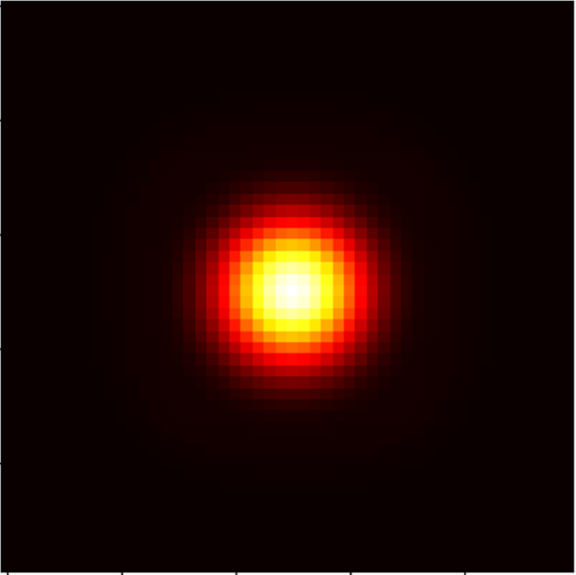
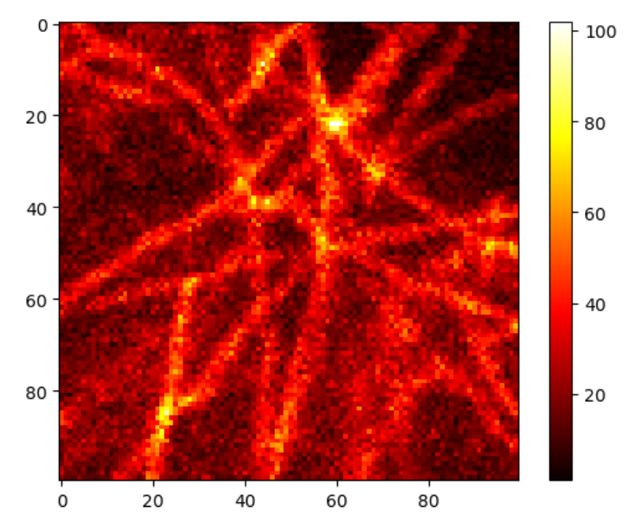
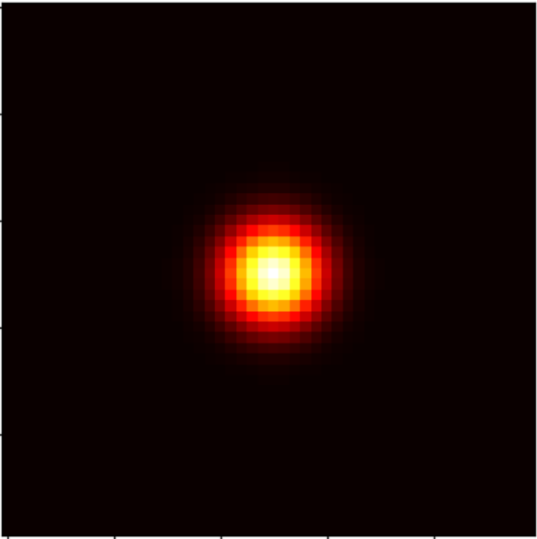
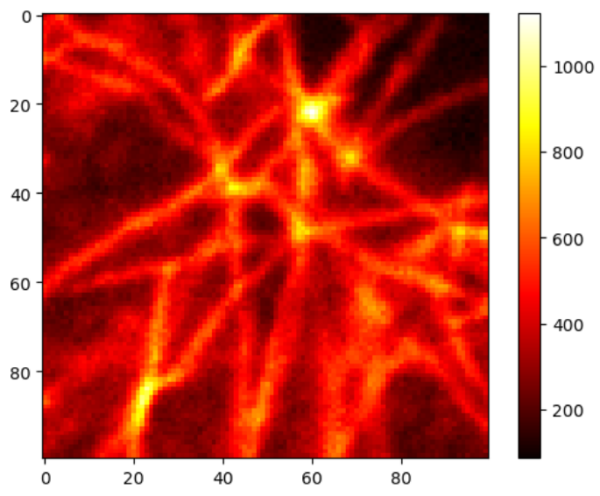
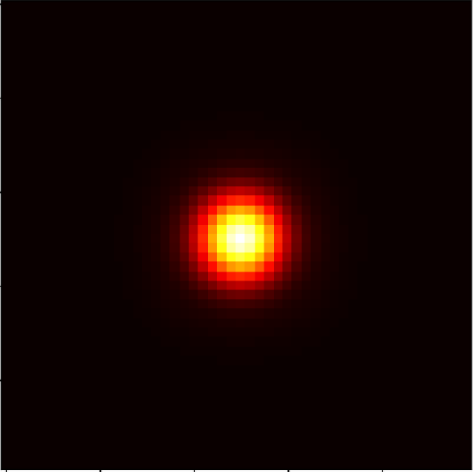
Image reconstruction
Sum all the images
Confocal with pinhole = 1.4 AU
Take the central element
Confocal with pinhole = 0.2 AU
Adaptive Pixel Reassignment
ISM image

Slide 12
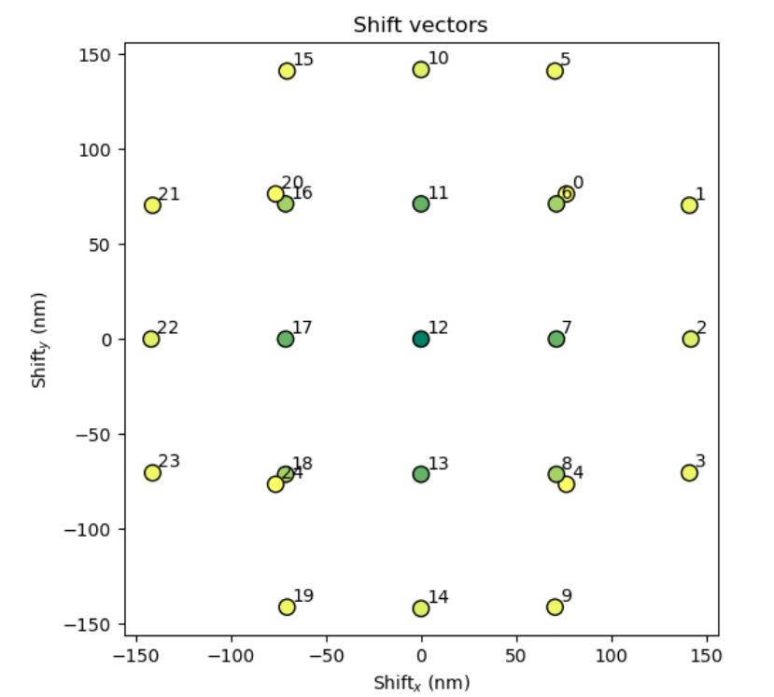
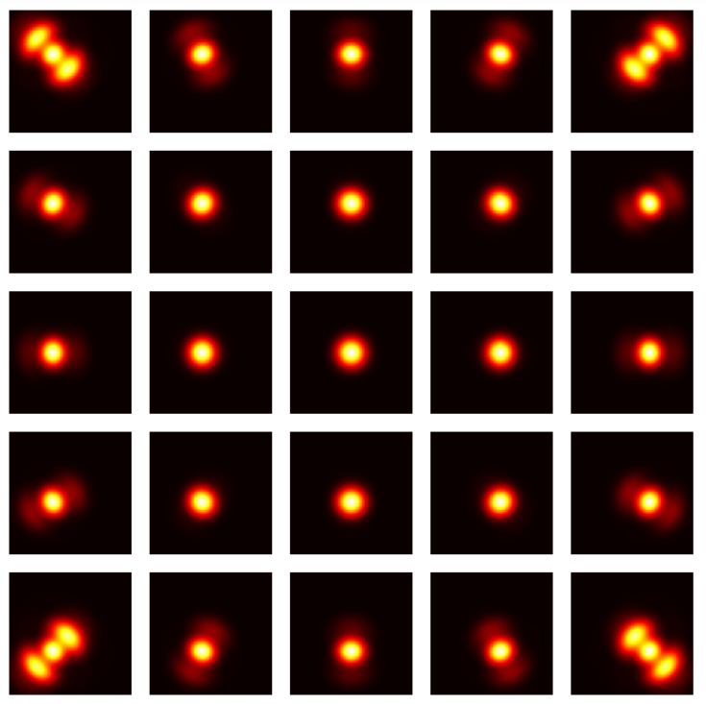
Pixel reassignment
The shift vector can be calculated based on the known parameters of my setup
Alternatively, I can find them by simulating the PSF of every SPAD and measure the displacement with respect to the central element.
Here i don’t consider possible errors in the experimental setup (inhomogeneities, misalignments…)
Simulated PSFs
Shift vectors

Slide 13
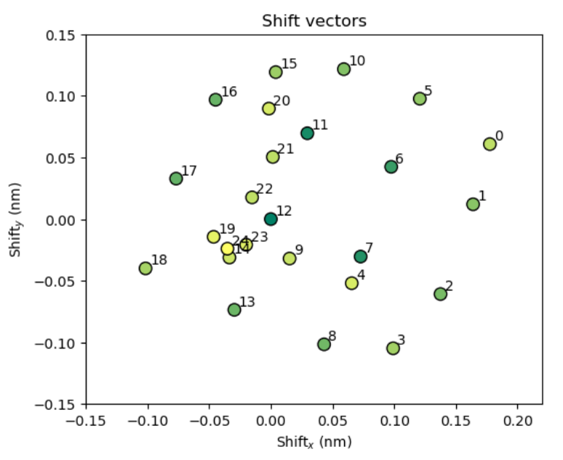
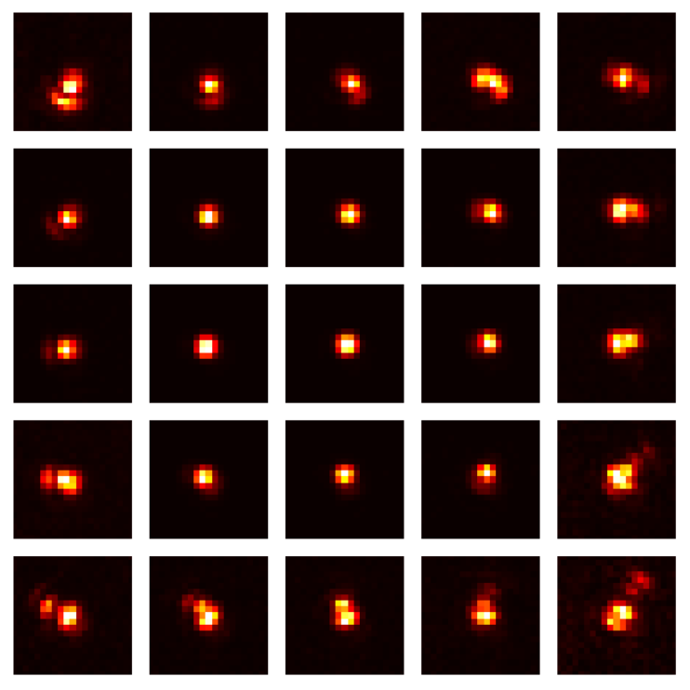
Pixel reassignment
To consider experimental errors, i can compute the shift vectors from the image of an unresolved object, effectively working with the experimental real PSFs
Experimental PSFs
Shift vectors

Slide 14
Adaptive Pixel reassignment
With Adaptive Pixel Reassignment, the shift vectors are estimate directly from the images, calculating the shift that maximizes their correlation
This method has some limitations, since it assumes all the images (and the PSFs) to be identical but shifted and modulated in intensity. These effect, however, are evident only for large detectors (>1 AU) and in the case of strong aberrations

Slide 15
Adaptive Pixel reassignment
With Adaptive Pixel Reassignment, the shift vectors are estimate directly from the images, calculating the shift that maximizes their correlation
This method has some limitations, since it assumes all the images (and the PSFs) to be identical but shifted and modulated in intensity. These effect, however, are evident only for large detectors (>1 AU) and in the case of strong aberrations

Slide 16
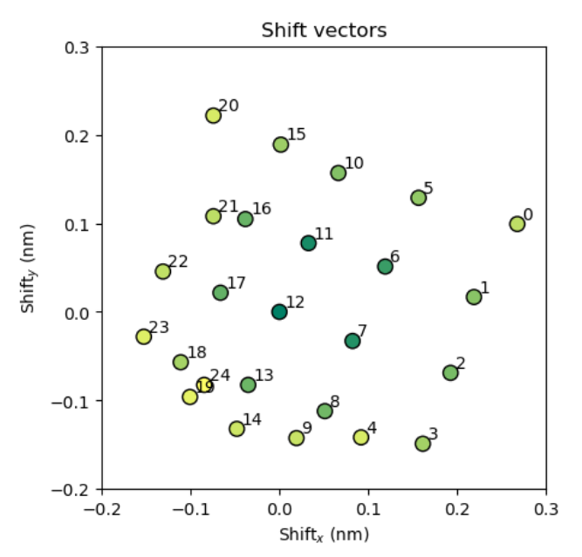
Adaptive Pixel reassignment
With Adaptive Pixel Reassignment, the shift vectors are estimate directly from the images, calculating the shift that maximizes their correlation
This method has some limitations, since it assumes all the images (and the PSFs) to be identical but shifted and modulated in intensity. These effect, however, are evident only for large detectors (>1 AU) and in the case of strong aberrations

Slide 17
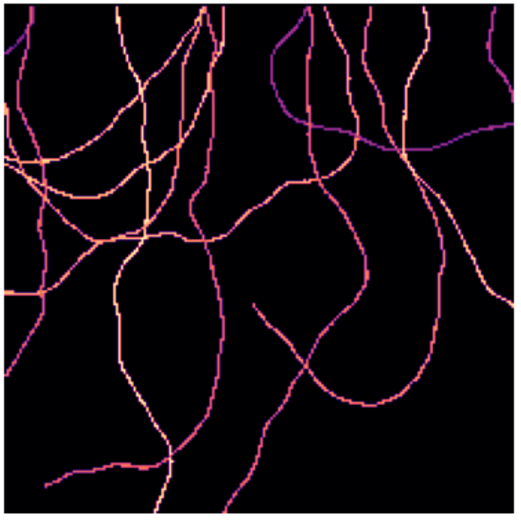
The ism imaging technique
Prepare the sample
Simulated tubulin filament

Slide 18
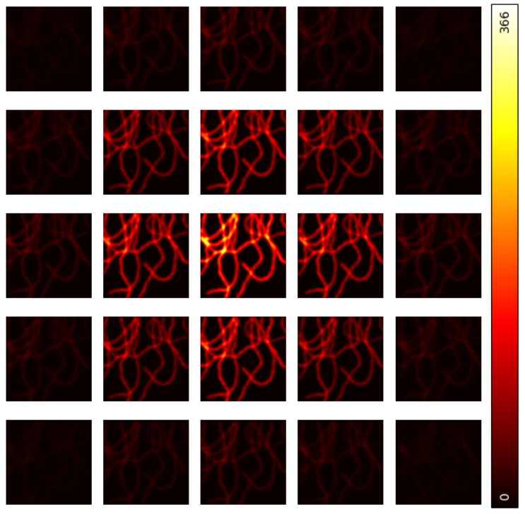
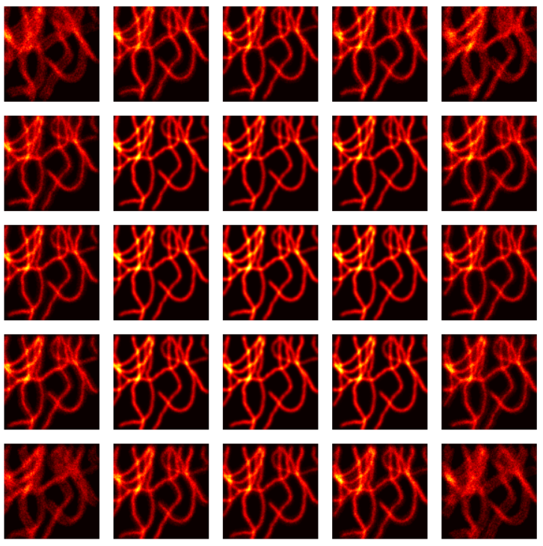
The ism imaging technique
Prepare the sample
Acquire the images
Acquired images normalized to the values of the central image
Acquired images without normalization

Slide 19
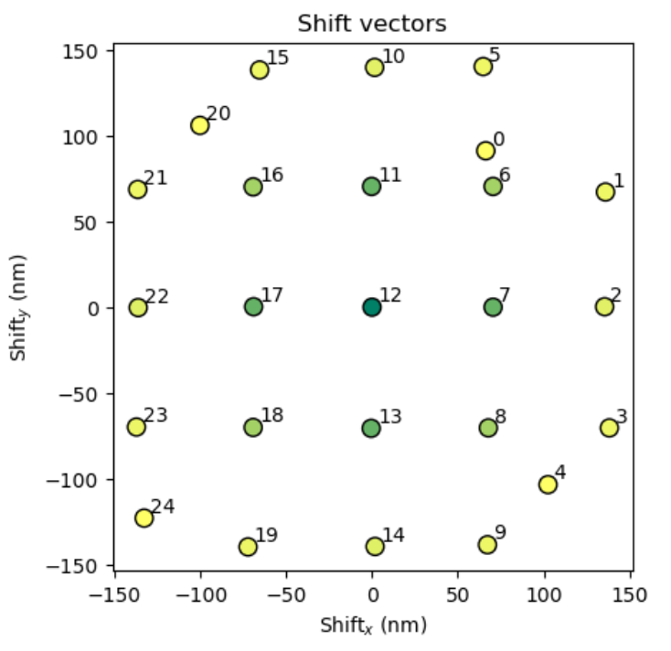
The ism imaging technique
Prepare the sample
Acquire the images
Calculate the shift vectors
Shift vectors found by APR from the simulated tubulin filaments

Slide 20
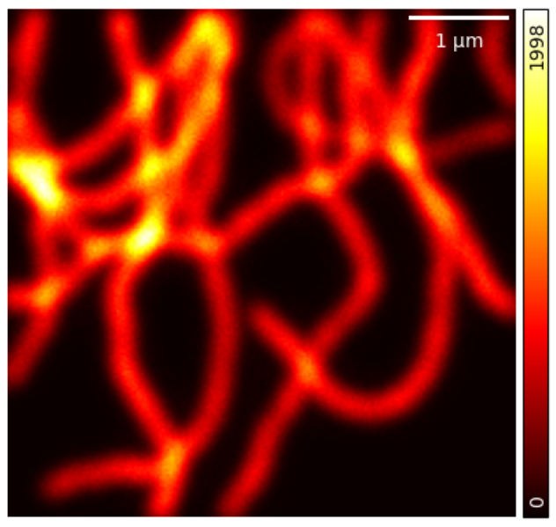
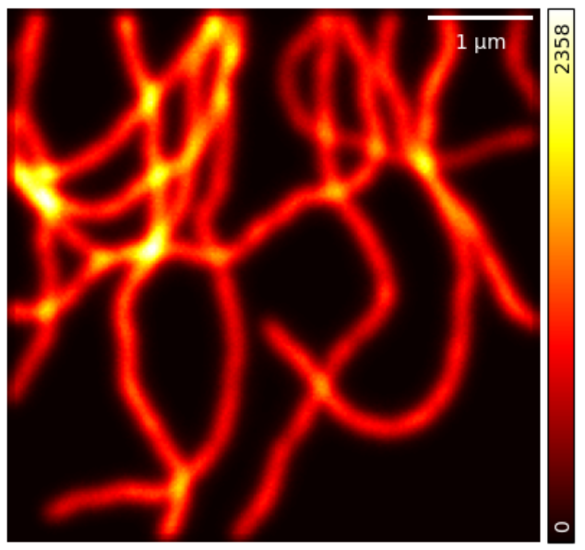
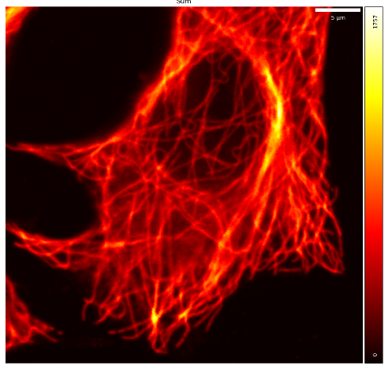
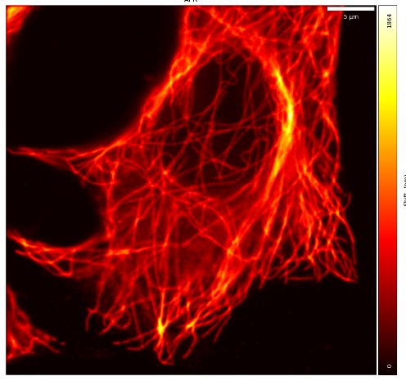
The ism imaging technique
Prepare the sample
Confocal image reconstructed by summing without shifting
Resolution = 204 nm
ISM image reconstructed by shifting and summing
Resolution = 147 nm
Acquire the images
Calculate the shift vectors
Confocal image reconstructed by summing without shifting
Resolution = 323 nm
ISM image reconstructed by shifting and summing
Resolution = 262 nm
Reconstruct the ISM image

Slide 21
ISM applications
Image improvement
Other techniques
Multi-image deconvolution
Focus ISM
Fluorescence Correlation Spectroscopy
Fluorescence Lifetime
Particle Tracking

Slide 22
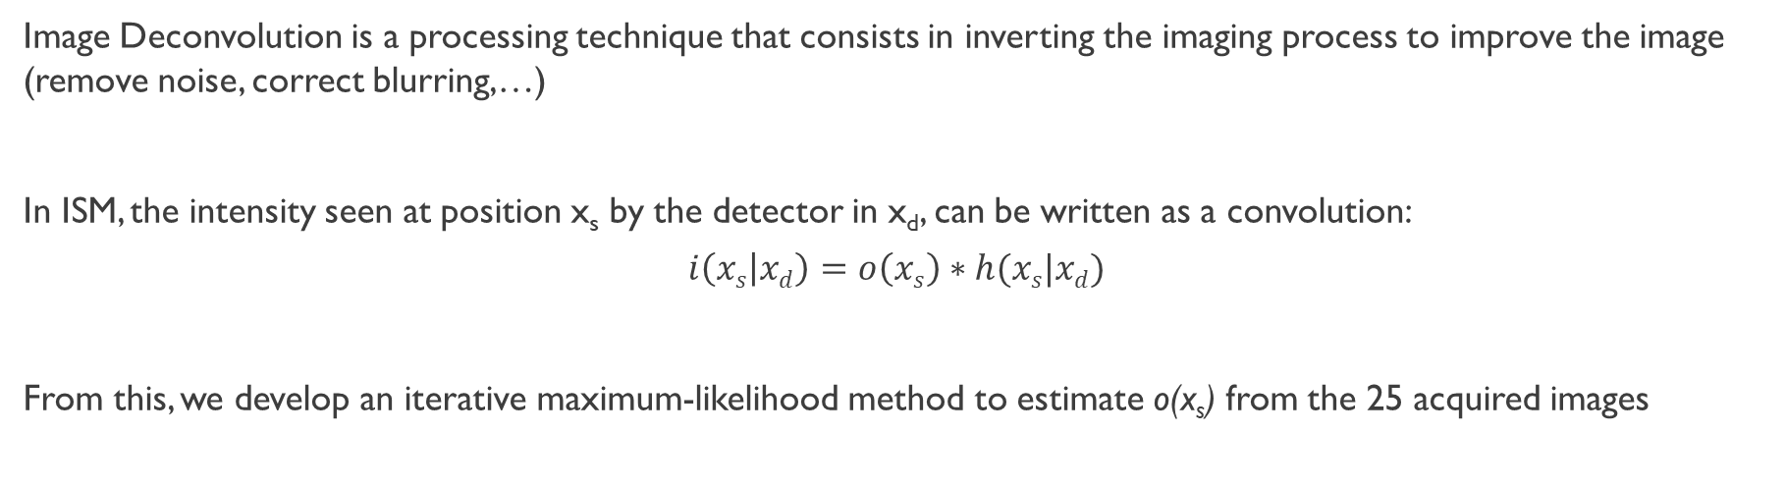
Multi-image deconvolution
Image Deconvolution is a processing technique that consists in inverting the imaging process to improve the image (remove noise, correct blurring,…)
In ISM, the intensity seen at position x_{s} by the detector in x_{d}, can be written as a convolution:
$$i\left(xs | xd\right)=o\left(xs\right)∗h(xs|xd)$$
From this, we develop an iterative maximum-likelihood method to estimate o(x_{s}) from the 25 acquired images
These are 25 problems!
Note
It can be demonstrated that the iterative process reassigns the photons in the image and conserves their total
number

Slide 23
Multi-image deconvolution
Deconvolution not only improves the image resolution, but also has a denoising effect. Particular care must be taken when choosing the iteration number
Confocal
ISM
Image Deconvolution

Slide 24
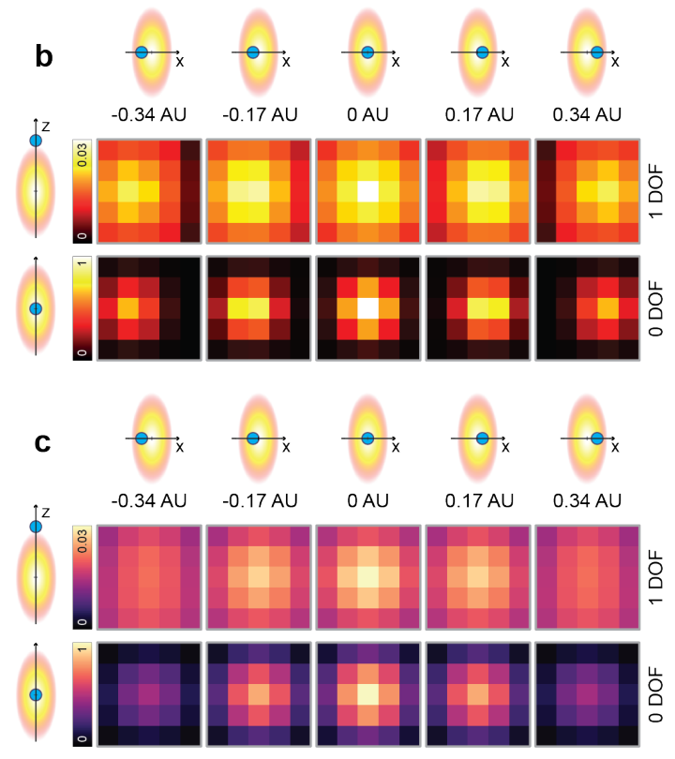
Focus-ism
The external elements of the array contain information about the out-of-focus planes!
We can check this by simulating the PSF of the different SPADs, and finding the related micro-images
After APR, the microimages are all centered and independent from the position of the object
The microimages are only rescaled by a factor proportional to the fingerprint of that specific plane, which is linked to the detection PSF
Microimages from various axial and lateral positions both before and after pixel reassignment

Slide 25
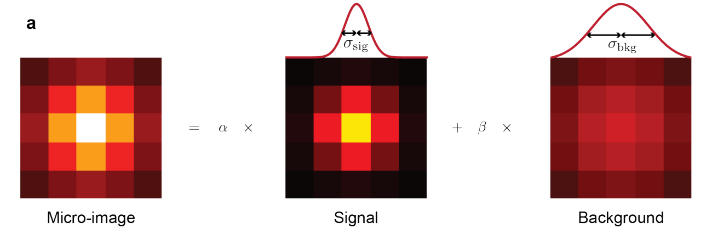
Focus-ism
To remove the contribution from the background, i could subtract the average intensity of the external SPADs
A more precise approach requires fitting every microimage with two gaussians: one with a smaller sigma (the in-focus signal) and a larger one (the out-of-focus light). Then the final image is reconstructed by using only the in-focus light
The micro-image is fitted with two normalized gaussian functions, weighted by the factors α and β, imposing α+β=1

Slide 26
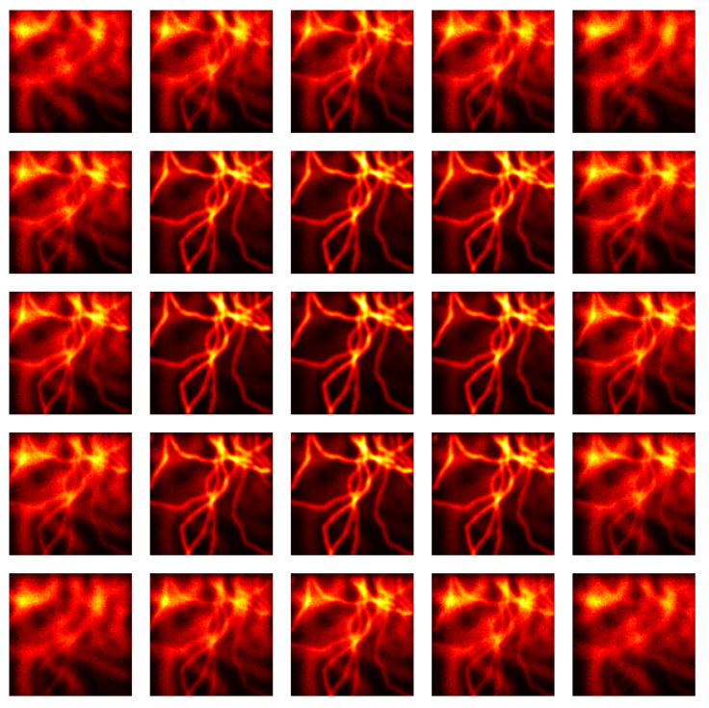
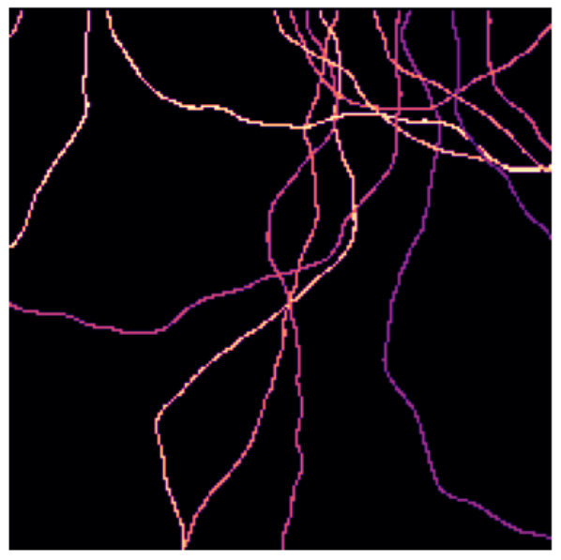
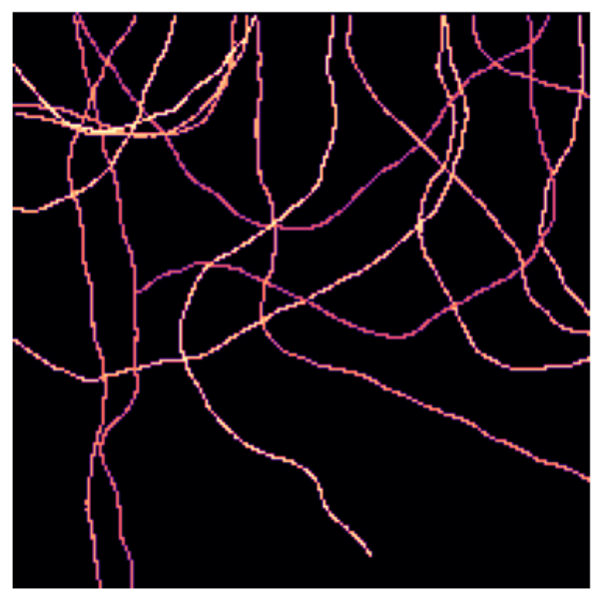
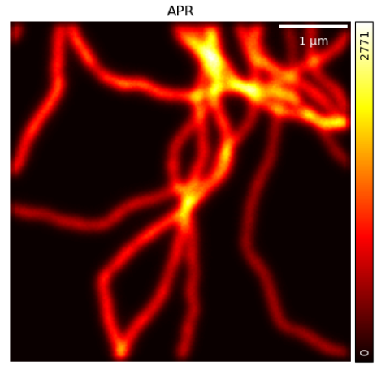
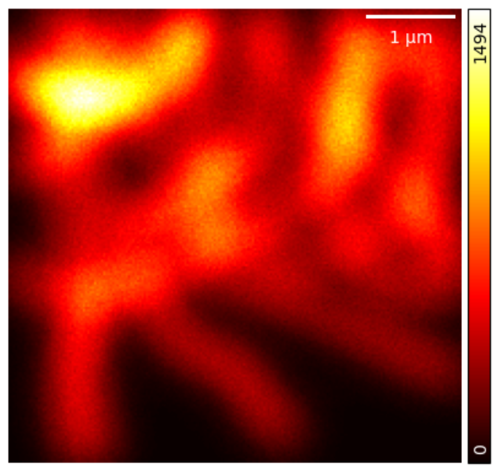
Focus-ism
In-focus plane out-of-focus plane

Slide 27
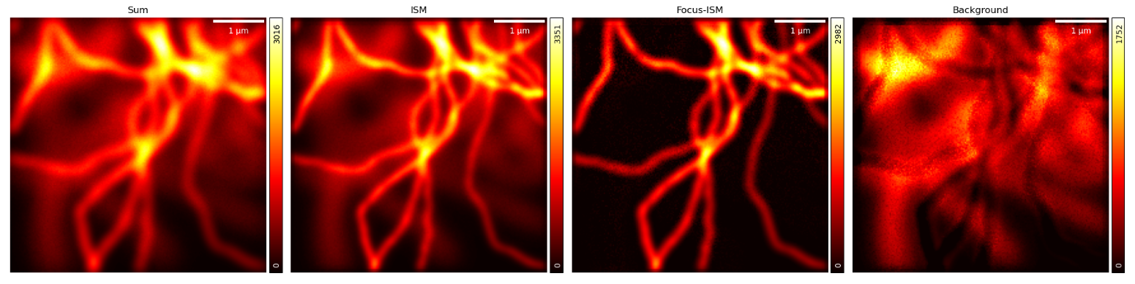
focus-ism
Sum (open pinhole 1.4 AU)
ISM (APR method)
Focus-ISM (in-focus)
Focus-ISM (out-of-focus)

Slide 28

Fluorescence Lifetime ISM (FLIsM)
In traditional FLIM, i record the arrival time of photons for every pixel, resulting in a 3-dimensional dataset (x, y, t) from which i extrapolate the fluorescence lifetime for every pixel.
Alternatively, I can aggregate the counts over a small area with an expected uniform lifetime, to increase the photons statistics
Typically, i want high resolution to investigate variations of τ over a small spatial scale, but also high SNR
Arrival times of photons over a varying number of pixels from a uniform mixture of Rhodamines. From blue to yellow, the area starts from 1x1 to a 128x128

Slide 29


Fluorescence Lifetime ISM (FLIsM)
The SPAD array allows a natural implementation of time-tagging for the detected photons, automatically acquiring 4-dimensional images (x, y, t, ch) and with APR we obtain a super-resolved, high-intensity FLIM image
The reconstruction order is (x,y,t,ch) (x,y,t) (x,y)
APR
Fit
Arrival times from different channels of a solution of Atto-633NHS in water
10 µm
10 µm

Slide 30





Fluorescence Lifetime ISM (FLIsM)
Histograms of the pixel values
0.2 AU
1.4 AU
2 µm
ISM
2 µm
2 µm

Slide 31


Spot-variation FCS
Diffraction limit
Spot-Variation FCS is a technique to detect spatial heterogeneity in the region by measuring the particle mobility over a tunable detection volume (trapping vs free diffusion)
The plot of ω₀² VS τ follows the function:
$$τ={ω02}/{4D}$$
from which I can understand wether the particle diffuses freely, is bound in microdomains or has other types of movement
Meshwork
Microdomains
Diffusion Time τ
Free diffusion
Free diffusion
Observation Spot Area ω₀²

Slide 32


Spot-variation fcs
The SPAD array can follow time fluctuations with an “unlimited” framerate and a time resolution of ∼100 ps,
Since every pixel of the array covers a specific area, “changing the detection area” is equivalent to summing the photons over a different subset of SPADs

Slide 33




Spot-variation FCS
Various auto-correlation and cross-correlation functions can be computed

Slide 34


Other correlation techniques
Spot-variation FCS provides a precise measurement of the diffusion coefficient and insights on the diffusion region
Dual-spot FCS, using the cross-correlation between two SPADs detects the directionality of motion, at the expense of a lower signal and igner noise
Space-Time Image Correlation (STICS) can be implemented as well
FCS can be combined with Fluorescence Lifetime by tagging the photon’s arrival with respect to the laser impulse and with respect to the general measurement time
Graph of svFCS from the previous data
Scheme of the cross-correlations for dual-spot FCS

Slide 35


Real-time single Particle tracking
Since the fingerprint changes when the object moves, i can implement a real-time particle tracking (RT-SPT)
Thanks to the asynchronous readout of the array, the position can be checked after a fixed, tunable interval or under other conditions
The movement along z can be detected by introducing an astigmatic lens in the setup

Slide 36

Real-time single Particle tracking
Since the fingerprint changes when the object moves, i can implement a real-time particle tracking (RT-SPT)
Thanks to the asynchronous readout of the array, the position can be checked after a fixed, tunable interval or under other conditions
The movement along z can be detected by introducing an astigmatic lens in the setup

Slide 37



Real-time single Particle tracking
Only the recentering of the FoV is required in real-time. Particle Tracking can be done off-line in post-processing with more precise techniques.
Other analysis can also be combined to tracking, like fluorescence lifetime
Analysis of the motion on lysosomes in a tubulin network

Slide 38
Bibliography
Zunino, A. et al., ‘Reconstructing the image scanning microscopy dataset: an inverse problem’, Inverse Problems, 39 (2023)
Castello, M., Tortarolo, G., Buttafava, M. et al. ’A robust and versatile platform for image scanning microscopy enabling super-resolution FLIM’. Nat Methods 16, 175–178 (2019)
Tortarolo, G., Zunino, A., Fersini, F. et al. ’Focus image scanning microscopy for sharp and gentle super-resolved microscopy’. Nat Commun 13, 7723 (2022)
Slenders, E. et al., ‘Confocal-based fluorescence fluctuation spectroscopy with a SPAD array detector’, Light: Science & Applications (2021)
Bucci, A. et al., ‘4D Single-Particle Tracking with Asynchronous Read-Out SPAD-Array Detector’, preprint (2023)
Perego, E. et al. , ‘Content-enriched fluorescence lifetime fluctuation spectroscopy to study bio-molecular condensate formation’, preprint (2023)
Rossetta, A., Slenders, E., Donato, M. et al., ‘The BrightEyes-TTM as an open-source time-tagging module for democratising single-photon microscopy’. Nat Commun 13, 7406 (2022)

